Slide 1
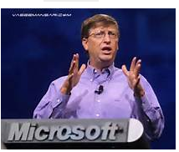
One Thing Successful People Never Do

Slide 2
Successful people (or the people talking or writing about them) often paint a picture of the perfect ascent to success. In fact, some of the most successful people in business, entertainment and sport have failed. Many have failed numerous times but they have never given up. Successful people are able to pick themselves up, dust themselves off and carry on trying.

Slide 3
Whatever success you are after there is one thing all radically successful people have in common: Their ferocious drive and hunger for success makes them never give up.

Slide 4
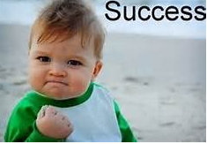
Some examples

Slide 5
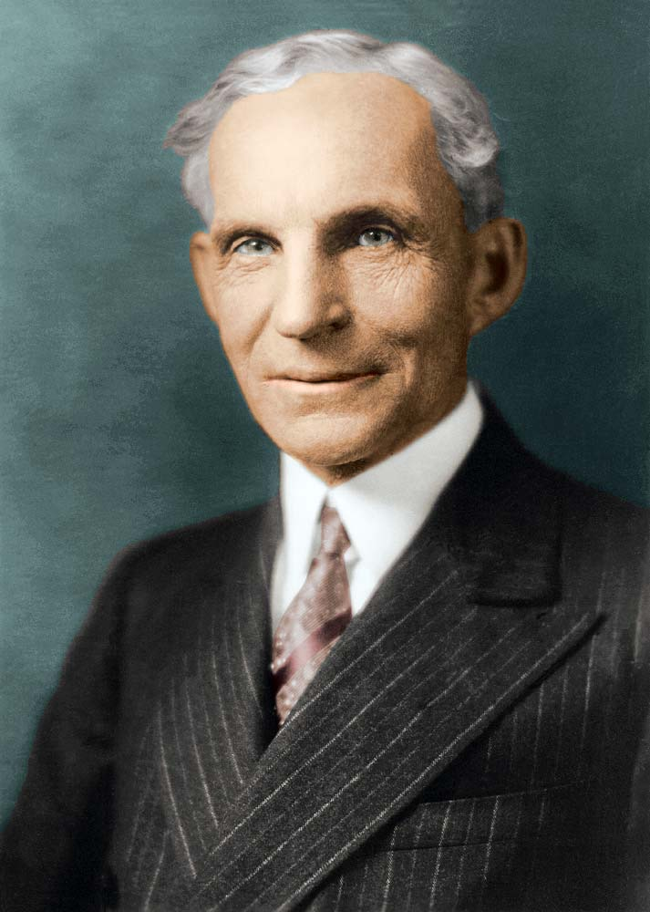

Slide 6
Henry Ford - the pioneer of modern business entrepreneurs and the founder of the Ford Motor Company failed a number of times on his route to success. His first venture to build a motor car got dissolved a year and a half after it was started because the stockholders lost confidence in Henry Ford. Ford was able to gather enough capital to start again but a year later pressure from the financiers forced him out of the company again. Despite the fact that the entire motor industry had lost faith in him he managed to find another investor to start the Ford Motor Company - and the rest is history.

Slide 7
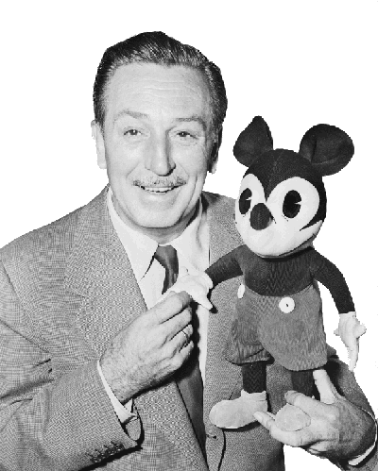

Slide 8
Walt Disney - one of the greatest business leaders who created the global Disney empire of film studios, theme parks and consumer products didn't start off successful. Before the great success came a number of failures. Believe it or not, Walt was fired from an early job at the Kansas City Star Newspaper because he was not creative enough! In 1922 he started his first company called Laugh-O-Gram. The Kansas based business would produce cartoons and short advertising films. In 1923, the business went bankrupt. Walt didn't give up, he packed up, went to Hollywood and started The Walt Disney Company.

Slide 9
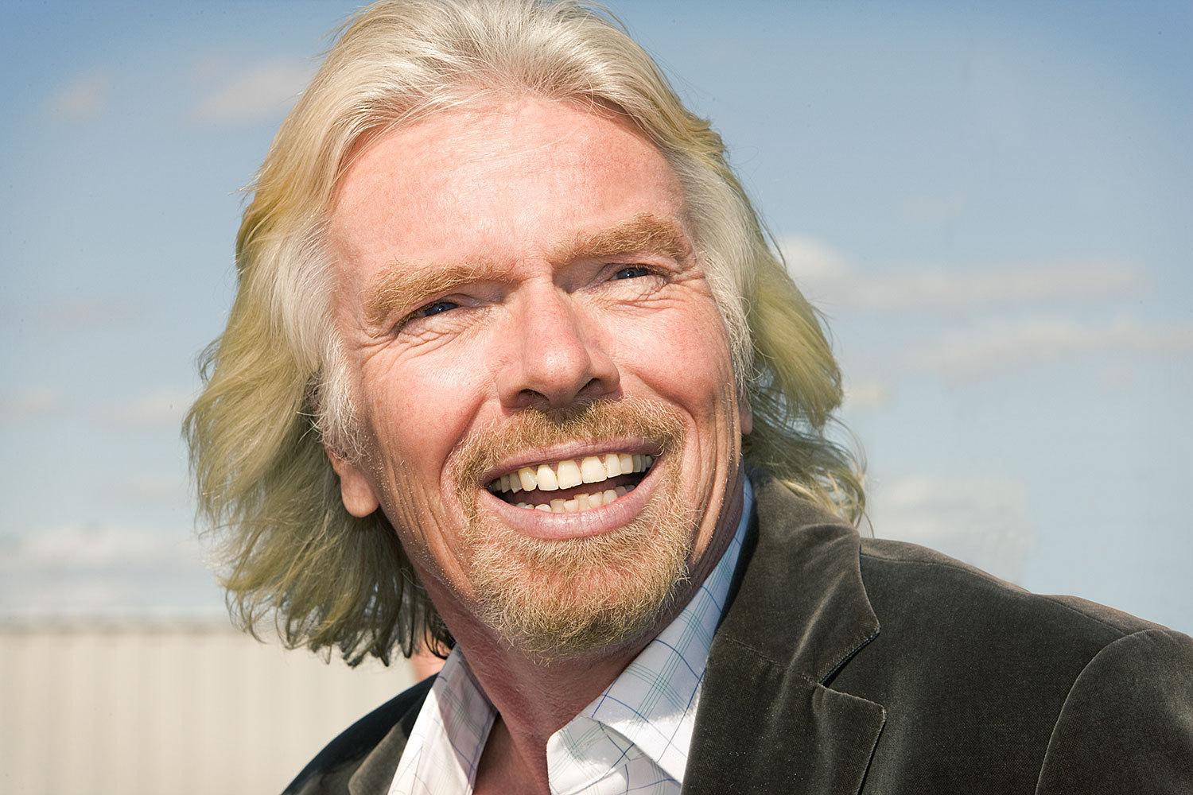

Slide 10
Rich struggled in school as a teenager battling with dyslexia. His grades were awful and one teacher told him he would either wind up in jail or become a millionaire. He didn’t like the way he was being taught in school so he decided to leave and make his own magazine at age 16 with no money to his name.
He landed $8000 in advertisements for the first issue (and this was in 1966) in what would be his first business venture. Richard Branson would go on to sell records, fly planes, and create over 200 other business ideas on his way to becoming a billionaire…

Slide 11
Richard Branson - He is undoubtedly a successful entrepreneur with many successful ventures to his name including Virgin Atlantic, Virgin Music and Virgin Active. However, when he was 16 he dropped out of school to start a student magazine that didn't do as well as he hoped. He then set up a mail-order record business which did so well that he opened his own record shop called Virgin. Along the way to success came many other failed ventures including Virgin Cola, Virgin Vodka, Virgin Clothes, Virgin Vie, Virgin cards, etc.

Slide 12
Branson succeeded at his magazine business because he cared about being an editor and was driven by passion. He speaks about success.
Ideally, since 80 percent of your life is spent working, you should start a business around something that is a passion of yours. If you’re into kite-surfing and you want to become an entrepreneur, do it with kite-surfing.
Look, if you can indulge in your passion, life will be far more interesting than if you’re just working. You’ll work harder at it, and you’ll know more about it. But first you must go out and educate yourself on whatever it is that you’ve decided to do – know more about kite-surfing than anyone else. That’s where the work comes in. But if you’re doing things you’re passionate about, that will come naturally.

Slide 13
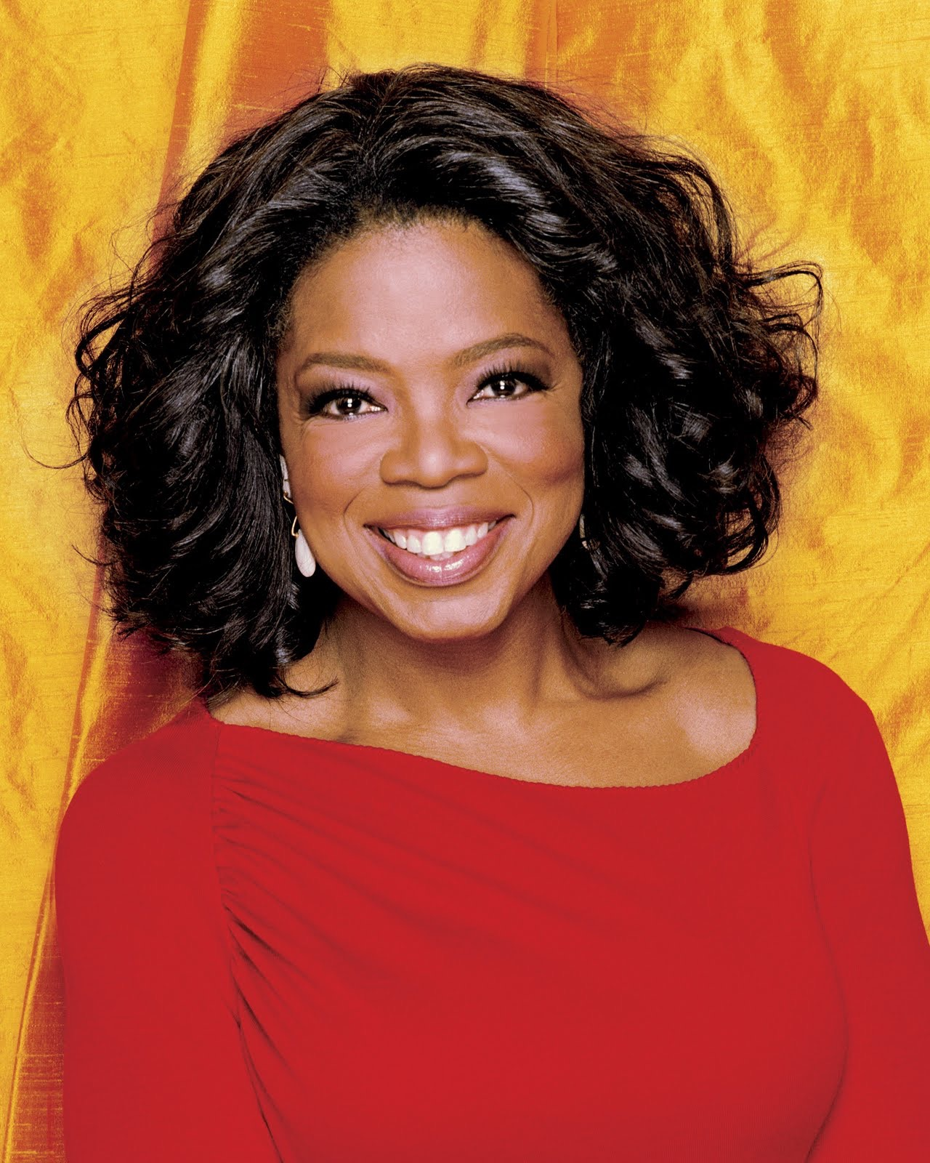

Slide 14
Oprah Winfrey - who ranks No 1 in the Forbes celebrity list and is recognised as the queen of entertainment based on an amazing career as iconic talk show host, media proprietor, actress and producer. In her earlier career she had numerous set-backs, which included getting fired from her job as a reporter because she was 'unfit for television', getting fired as co-anchor for the 6 O'clock weekday news on WJZ-TV and being demoted to morning TV.

Slide 15
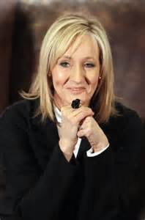

Slide 16
Joanne’s mother had died a few years earlier, and now she was a single parent (recently divorced) with no job, living off welfare benefits so she could provide for her young daughter. Worst yet, she was battling extreme depression and on the verge of suicide.
But, she had an idea…and belief that it was important. A few years later and still on welfare, Joanne submitted her manuscript to 12 publishers. They all rejected it. The 13th publisher took a look and gave her a chance. Joanne (J.K.) Rowling would have her first book published, Harry Potter and the Sorcerer’s Stone…

Slide 17
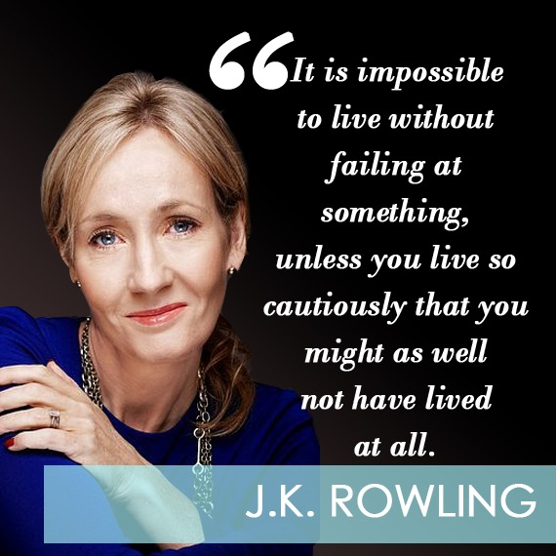

Slide 18
J.K. Rowling - who wrote the Harry Potter books selling over 400 million copies and making it one of the most successful and lucrative book and film series ever. However, like so many writers she received endless rejections from publishers. Many rejected her manuscript outright for reasons like 'it was far too long for a children's book' or because 'children books never make any money'. J.K. Rowling's story is even more inspiring because when she started she was a divorced single mom on welfare

Slide 19
In her 2008 Harvard Commencement Address, Rowling talks about succeeding while seeing herself as a complete failure. Because she had failed the only thing left was to do work that truly mattered to her: Failure meant a stripping away of the inessential. I stopped pretending to myself that I was anything other than what I was, and began to direct all my energy to finishing the only work that mattered to me. Had I really succeeded at anything else, I might never have found the determination to succeed in the one area where I truly belonged. I was set free, because my greatest fear had been realized, and I was still alive, and I still had a daughter whom I adored, and I had an old typewriter, and a big idea. And so rock bottom became a solid foundation on which I rebuilt my life.

Slide 20
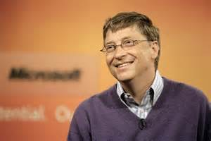

Slide 21
Bill Gates -co-founder and chairman of Microsoft set up a business called Traf-O-Data. The partnership between him, Paul Allen and Paul Gilbert was based on a good idea (to read data from roadway traffic counters and create automated reports on traffic flows) but a flawed business model that left the company with few customers. The company ran up losses between 1974 and 1980 before it was closed. However, Bill Gates and Paul Allen took what they learned and avoided those mistakes when they created the Microsoft empire.

Slide 22
History is littered with many more similar examples:
Milton Hershey failed in his first two attempts to set up a confectionary business.
H.J. Heinz set up a company that produced horseradish, which went bankrupt shortly after.
Steve Jobs got fired from Apple, the company he founded. Only to return a few years later to turn it into one of the most successful companies ever

Slide 23
Do You Believe in Yourself?

Slide 24
Scratch Your Own Itch
Stop trying to “find” your passion. Do what you like and enjoy. And experience new things on a regular basis. Chances are you are wasting your time if you spend it “trying to find your passion.” We all have likes and dislikes. We have interests and things we never want to do. Do more of what you like and what makes you happy. But don’t forget to experience the world around you. Who knows when inspiration will strike, but when it does be ready to act on it.

Slide 25
You are in the driver seat. So buckle up and drive.
Steve Jobs said, “Everything around you that you call life was made up by people that were no smarter than you, and you can change it, you can influence it, you can build your own things that other people can use.” Simply put, regardless of your circumstances, you are in charge of where your life goes. The reason we love “rags-to-riches” stories is that they can happen, and do happen, every day.

Slide 26
You need to stop distracting yourself and start inspiring yourself.
What are you accomplishing by watching the TV, reading your social feeds, and sending pictures back and forth? If the TV and your phone work as distractions then try to limit wasting your time. If you are watching, reading, and listening to things that inspire you…then you are on the right track. Surround yourself with people that inspire you, and you’ll do amazing work.

Slide 27
Big thinking actually does work.
If you want to do something big you have to think big. Too many times we are told that are dreams are just that…dreams. But the only way a dream becomes a reality is by truly believing you can make it happen. As said in The Pursuit of Happiness: “You got a dream… You gotta protect it. People can’t do somethin’ themselves, they wanna tell you that you can’t do it. If you want somethin’, go get it. Period.”

Slide 28
Motion creates motion…and it creates ideas.
When you start moving towards a goal it drives you forward even further. This is why just the act of “doing something” can help people get into a better mindset. Motion also gets the mind moving and creates new ideas. Moral of the story: Get out and do something, even if it is small. Then let the snowball effect take place!

Slide 29
You better start trying new things and challenging yourself ASAP!
How many times can you fail? The answer is none if you don’t try anything new or challenging. How many times can you get back up after you don’t succeed? But the most important question to ask yourself is: How much can you learn from not succeeding the first time? Start “failing” today and change the way you perceive this word. See it as an opportunity for growth and learning. See it as a way to test new ideas and improve understanding. See it is as a necessary step to success and not the “end” of anything.

Slide 30
Live for others not yourself.
What can you do to help people? What problems do you have that others might have as well? What can you contribute to this world… Living for others is simple. It doesn’t mean letting go of your goals and aspirations, instead it’s about merging those goals with the needs of others. Do that.

Slide 31
One final quote from J.K. Rowling:
It is impossible to live without failing at something, unless you live so cautiously that you might has well not have lived at all, in which case you have failed by default.
Go on and try something new. Scratch your itch and see what happens. But above all else, keep believing in yourself.
AJ Juliani 2016

Slide 32
So, the one thing successful people never do is:
Give up!

Slide 33
That’s All!

